Slide 1
Automated Text Analytics for Stock Market prediction

Slide 2

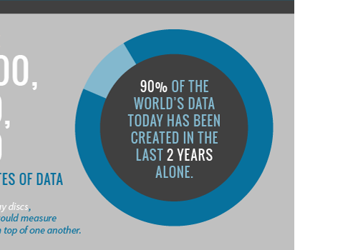
Problem Statement
2.5 quintillion bytes of data produces daily
SINTEF. "Big Data: for better or worse: 90% of world's data generated over last two years.“
ScienceDaily. ScienceDaily, 22 May 2013.
40 zettabytes of data by 2020
-cloudtweaks.com-

Slide 3
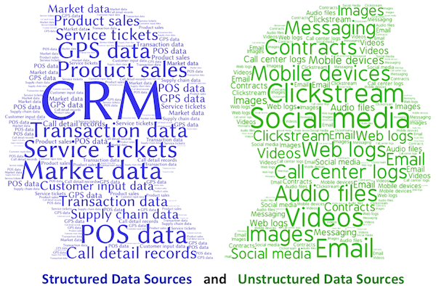
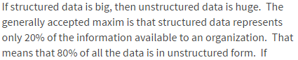

Problem Statement
Daniel Gutierrez - Text Analytics : The Next Generation of Big Data

Slide 4
Problem Statement
This vast amount of unstructured data are seemingly impossible for human to handle

Slide 5

Problem Statement
STOCK MARKET

Slide 6

Problem Statement
Factors that affect stock market:
Media
Public opinion
Natural disasters
Political and social unrest
Supply and demand
Monetary policy

Slide 7
Problem Statement
Immediate access to news and getting ahead of others in trading

Slide 8
Objective
Use text analytics to process unstructured data from news articles and predict investor’s sentiment towards it

Slide 9
Objective
Use natural language processing to generate trading signals as close to human based understanding

Slide 10
Objective
Create a program that provides an immediate and automated suggestion for stock exchange based on media in real time

Slide 11




Project background
Web Scraping
Natural Language Processing
Machine Learning

Slide 12
Related Works

Slide 13
Financial Stock Market Forecast using Data Mining Techniques
K. Senthamarai Kannan, P. Sailapathi Sekar, M.Mohamed Sathik and P. Arumugam
Goal
Data mining to predict stock prices
Dataset
Historical stock prices
technique (technical indicators)
Typical prices
Chaikin money flow indicator
Stochastic movement index
Relative strength index
Bollienger bands
Moving average

Slide 14
DATA AND TEXT MINING OF FINANCIAL MARKETS USING NEWS AND SOCIAL MEDIA
Zhichao Han (university of manchester)
Goal
Stock price forecasting using various data mining with technical indicators and text mining
Dataset
Open-high-low-close (ohlc) of s&P securities
News from reuters site archive
technique
Bag of words
Latent Dirichlet Allocation (LDA)
Sentiment analysis

Slide 15
Stock Market Prediction from WSJ: Text Mining via Sparse Matrix Factorization
Felix Ming Fai Wong, Zhenming Liu, Mung Chiang (Princeton University )
Goal
Predict closing price at the end of trading day
Dataset
Daily open and close price
WSJ news
technique
Leveraging correlation between stocks

Slide 16
Text Mining of News Articles for Stock Price Predictions
Kim-Georg Aase (NTNU)
Goal
Find relationship between breaking news and stock prices
Use sentiment analysis on news articles to automatically generate trading signals
Dataset
Breaking news
technique
Text preprocessing (tokenization, stop-word removal, stemming)
News categorization (support vector machine)
Trading strategy

Slide 17
Text Opinion Mining to Analyze News for Stock Market Prediction
Yoosin Kim, Seung Ryul Jeong, Imran Ghani
Goal
reveal that news’ sentiment can be used in predicting stock price fluctuations
Dataset
Specific company news from naver.com
technique
Sentiment analysis using ratio of stock price changes following the total number of news containing that word

Slide 18
Gantt chart
No | Task | 2016
 |  | September |  |  |  | October |  |  |  | November |  |  |  |  | December
 |  | 1 | 2 | 3 | 4 | 1 | 2 | 3 | 4 | 1 | 2 | 3 | 4 | 5 | 1 | 2 | 3 | 4
1 | Literature Review
2 | Big Data
3 | Stock Market
4 | Artificial Intelligence

Slide 19
Gantt chart
No | Task | 2017
 |  | January |  |  |  | February |  |  |  | March |  |  |  |  | April
 |  | 1 | 2 | 3 | 4 | 1 | 2 | 3 | 4 | 1 | 2 | 3 | 4 | 5 | 1 | 2 | 3 | 4
5 | Web Scraper
6 | Natural Language Toolkit
7 | Machine Learning Algorithm
8 | Application Program

Slide 20




Project flow

Slide 21
Methodology

Slide 22
Machine learning
Pre-processing
Feature Extraction / Generation
Classification

Slide 23

web scraper
Endpoint
URL
Extraction
Fetch HTML file
Stripping
Remove HTML tags

Slide 24

web scraper
http://www.thestar.com.my/business/

Slide 25

web scraper
http://www.nst.com.my/business

Slide 26
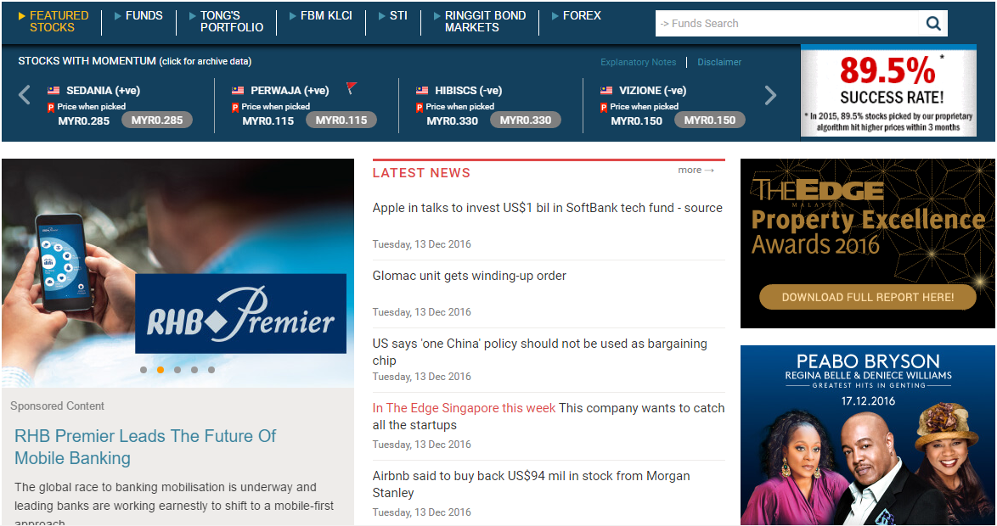
web scraper
http://www.theedgemarkets.com/my

Slide 27
Natural Language processing (using nltk)
Tokenizing
Stop-word Removal
Stemming

Slide 28
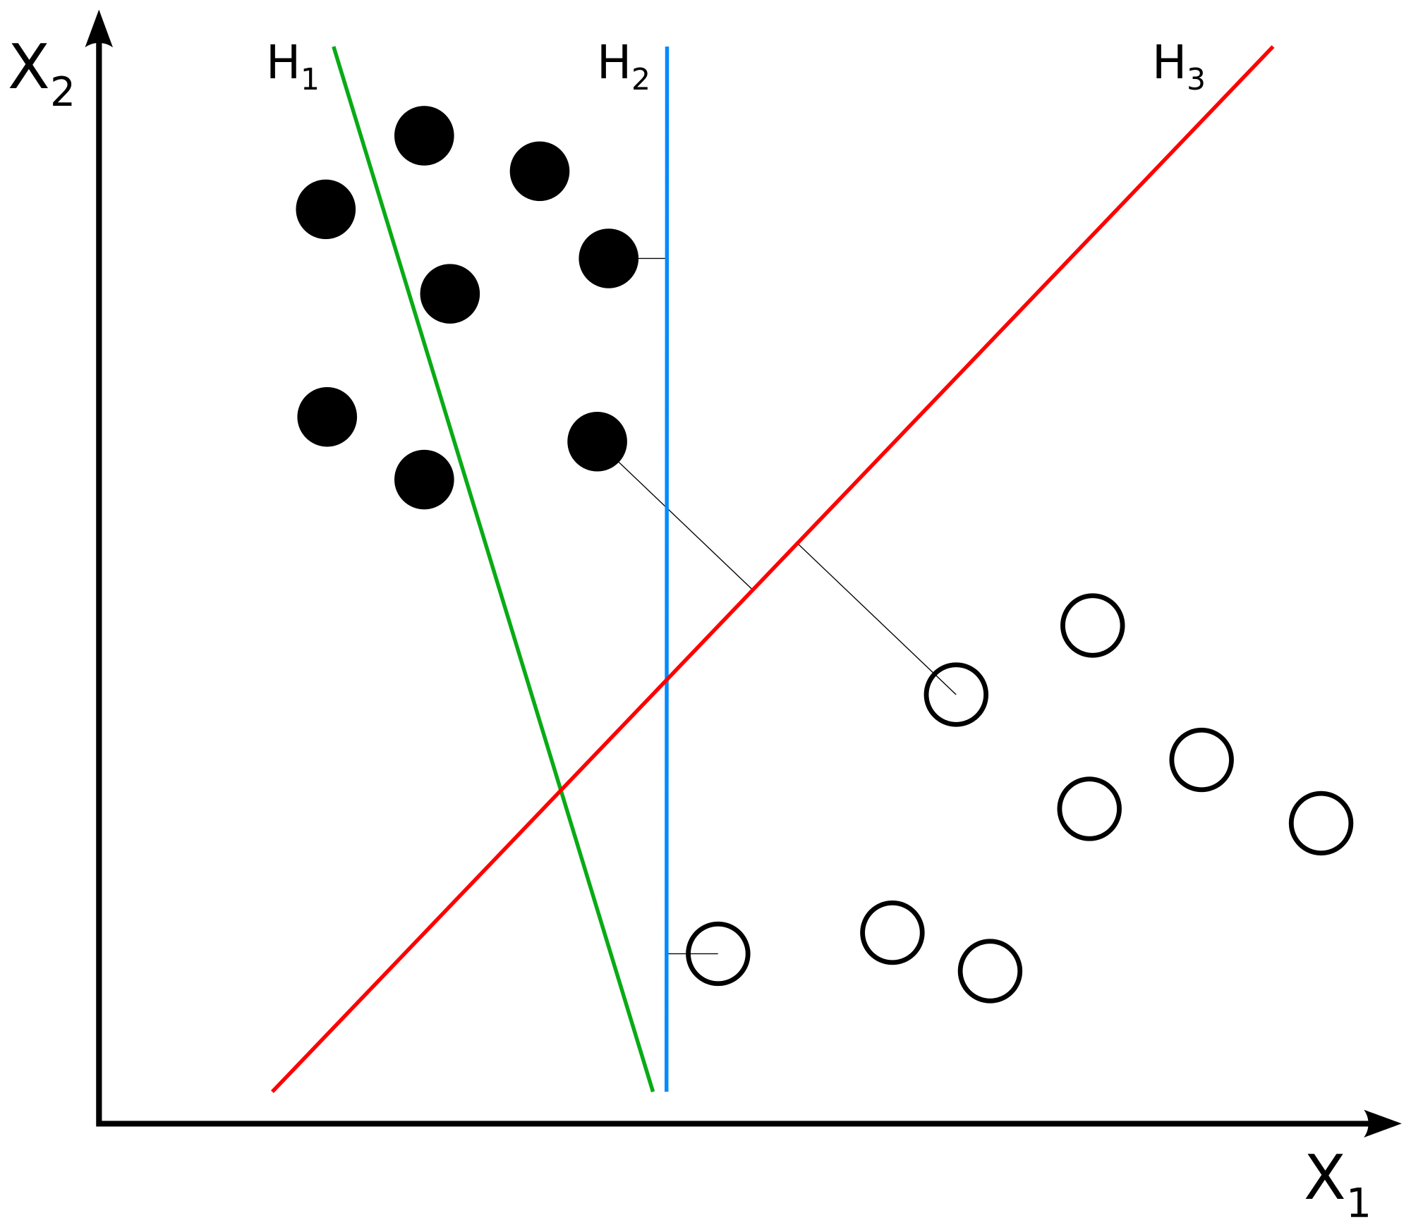
Machine Learning (Support Vector Machine)

Slide 29
Preliminary result

Slide 30
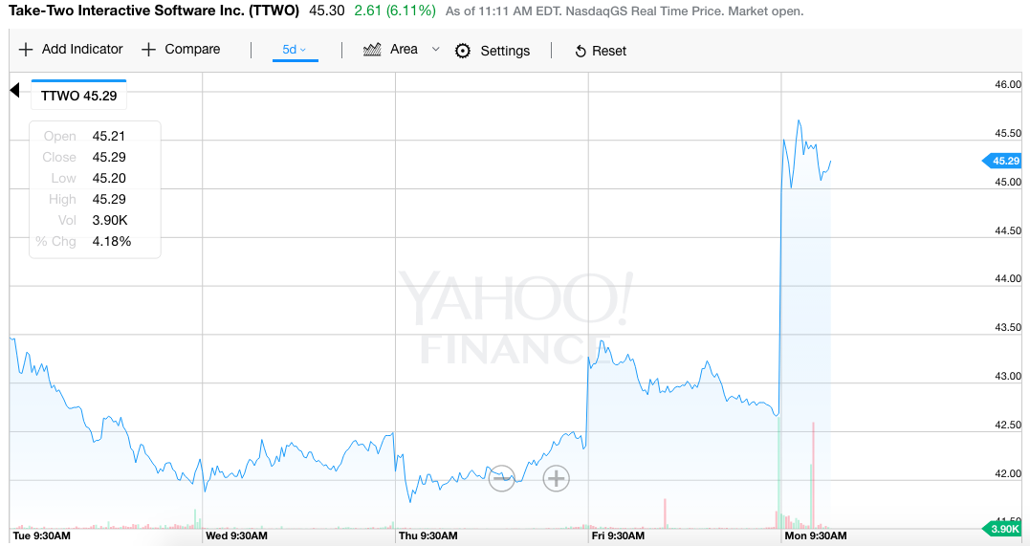


Rockstar games

Slide 31
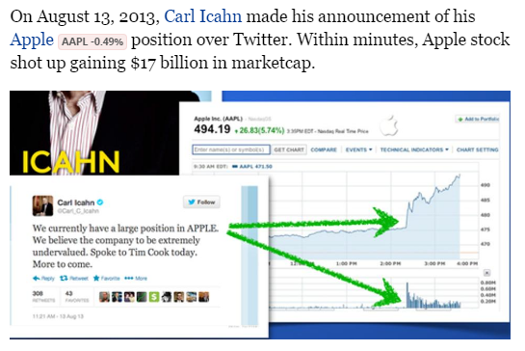
Credit to : http://www.forbes.com/sites/quora/2013/09/10/does-social-media-affect-capital-markets/#41a5dd9056f9

Slide 32
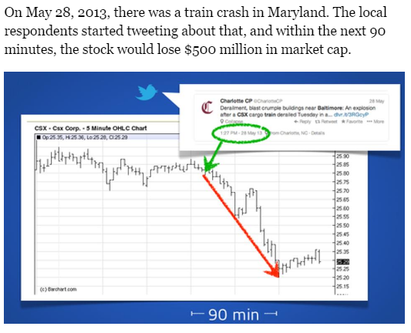
Credit to : http://www.forbes.com/sites/quora/2013/09/10/does-social-media-affect-capital-markets/#41a5dd9056f9

Slide 33
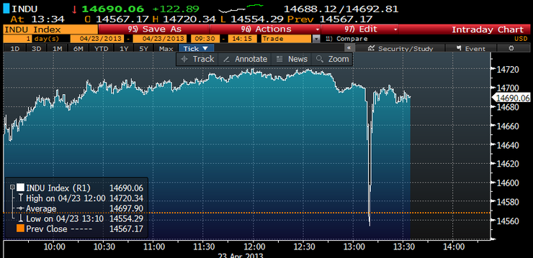
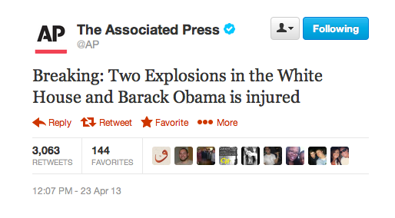
Credit to : https://www.bloomberg.com/news/articles/2013-04-23/a-fake-ap-tweet-sinks-the-dow-for-an-instant

Slide 34


